Slide 1



Let’s Talk Science!
Celeste Barajas
Arizona Space Grant Symposium
Tucson, AZ 04/21/2012
Mentors:
Bill W. Plant, Flandrau Science Center
Daniel Stolte, UANews
Shelley Littin, Space Grant mentor

Slide 2
At a glance
UANews
  About
  Science writing
    Key points: good interview techniques and knowing your audience
    Challenges
Flandrau Science Center
  About
  Program development and improvement
    Public outreach

Slide 3
How to inform science?

Slide 4
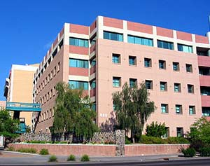
UANews
The Office of University communications
Current news
Mentors:
Daniel Stolte, Head science writer
Shelley Littin, Space grant intern

Slide 5

Science Writing
Knowing the audience
- Be creative
- Concise writing
Interviews
  - Keep it simple!
  Transcribing
  - Finding key points
Notes:
Knowing the audience
Be creative
Concise writing

Slide 6
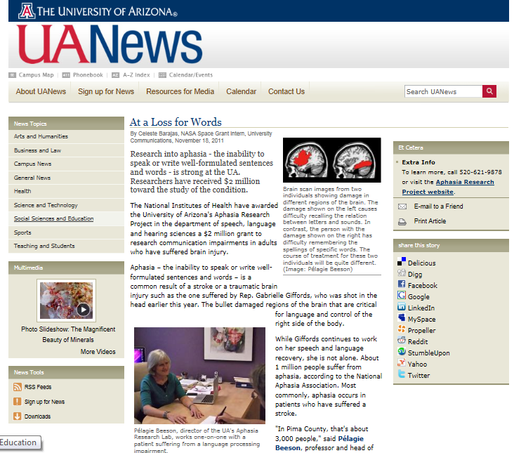
Notes:
Challenges in science writing

Slide 7
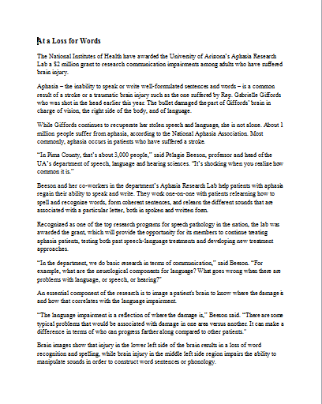
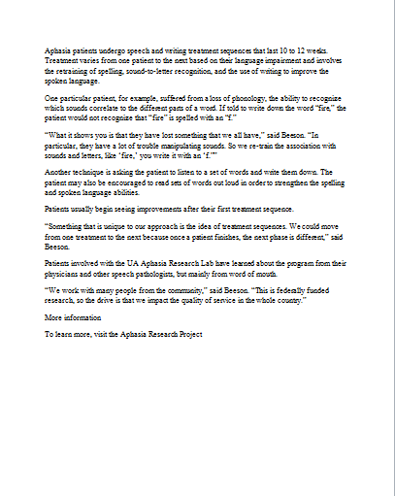
Notes:
One of the challenges

Slide 8
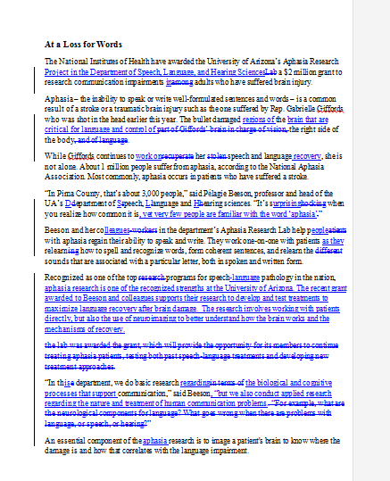
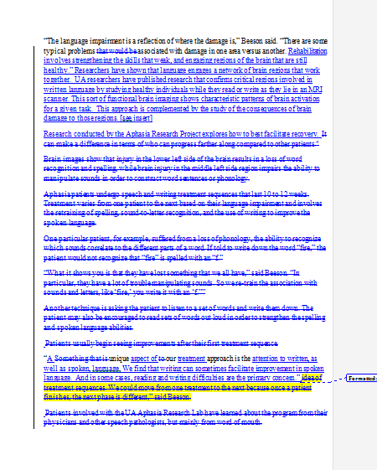

Slide 9
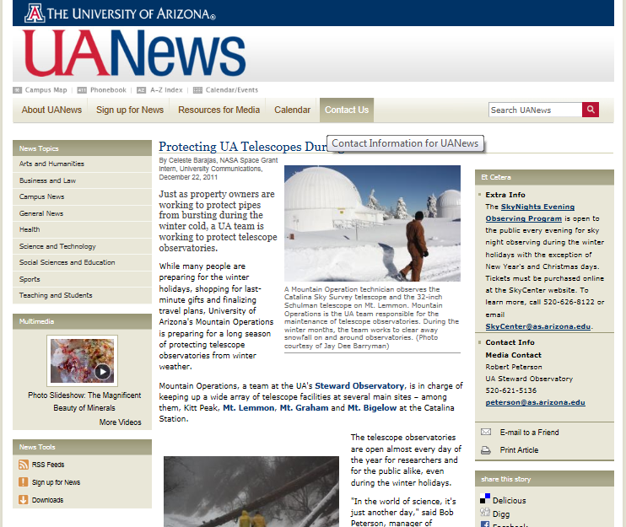

Slide 10
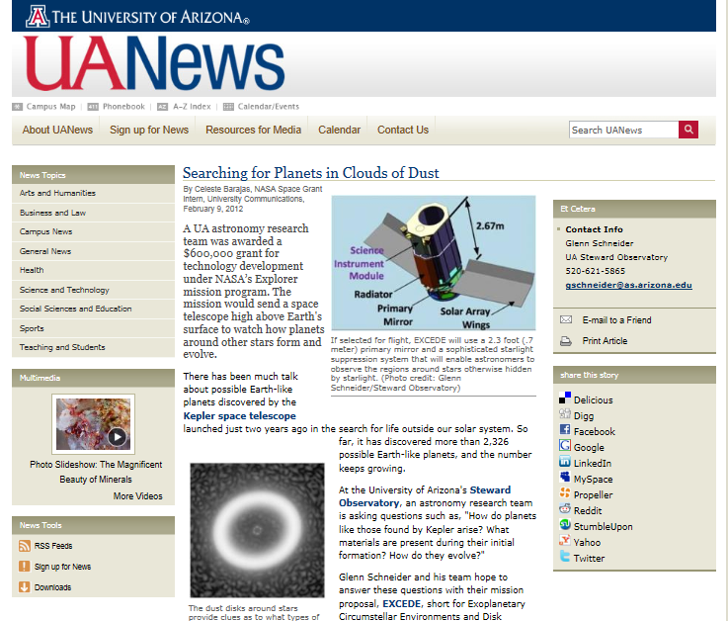

Slide 11
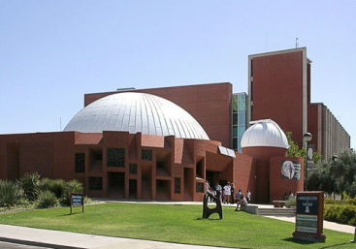
Flandrau Science Center
Public Outreach
  Education programs
  Planetarium
  Exhibits: mineral museum animal survival strategies

Slide 12
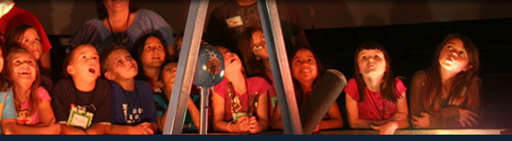
Public Outreach
Improving programs
  Collaboration
  Brainstorming!
  “Tucson Sky Tonight”
Developing new programs
  Top UA research
  “Exoplanets”

Slide 13
Thank You!

Slide 14
Bibliography
Arizona space grant consortium [Logo]. Retrieved April 11, 2012, from: http://spacegrant.arizona.edu/about/logos
Barajas, C. (2011, November 18). At a loss for words. UANews. Retrieved from: http://uanews.org/node/43362
Barajas, C. (2011, December 22). Protecting UA telescopes during the winter cold. UANews. Retrieved from: http://uanews.org/node/43860
Barajas, C. (2012, February 9). Searching for planets in clouds of dust. UANews. Retrieved from: http://uanews.org/node/44626
UAScience flandrau [Logo]. Retrieved April 11, 2012, from: http://www.flandrau.org/
University of Arizona, flandrau science center & planetarium, background: space sciences building [Picture]. 2004. Retrieved April 11, 2012, from: http://www.panoramio.com/photo/15944838
University of Arizona: UANews [Logo]. Retrieved April 11, 2012, from: http://uanews.org/
University services building [Picture]. Retrieved April 11, 2012, from: http://www.arizona.edu/buildings/university-services-building
Vintage trilby hat with press pass isolated on white [Picture]. Retrieved April 11, 2012, from: http://www.salon.com/2010/08/26/who_is_a_journalist/

